Slide 1

Python Level 2
Lesson 6: Pip! Pip! Hooray!

Slide 2
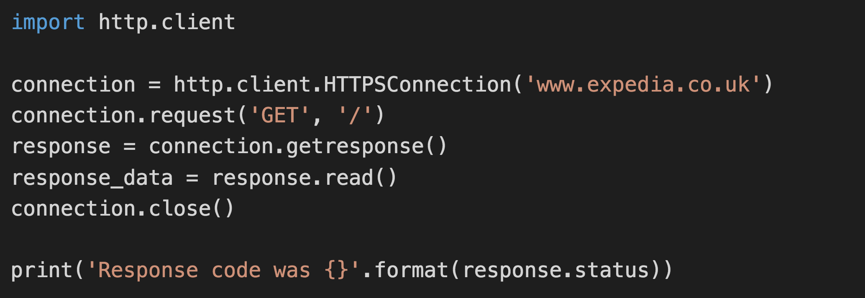

Last time

Slide 3
Pip Installs Packages
Python Package Index: https://pypi.python.org/pypi
To install a package:
pip3 install <packagename>
For a specific version:
pip3 install <packagename>=<version>
Eg: pip3 install mypackage=0.1.0
You know what’s coming…

Slide 4
Pip Installs Packages
Python Package Index: https://pypi.python.org/pypi
To install a package:
pip3 install <packagename>
You know what’s coming…
There’s a problem using pip - what is it?

Slide 5
Version Conflicts, System conflicts
What happens if
Program A needs version 1 of a module
Program B needs version 2 of the same module
The solution: virtualenv
pip3 install virtualenv

Slide 6
Creating a new virtual environment
MacOS:
virtualenv pythonL2
source pythonL2/bin/activate
Windows:
virtualenv pythonL2
pythonL2\Scripts\activate
Your prompt will change to reflect you’ve started your virtual environment
PyCharm user? I’ll show you.
Other IDEs, you’re on your own – sorry!

Slide 7
Using our virtual environment
We’re going to need a new module for the rest of today’s class:
Activate your virtual environment if you haven’t already
Install the module “web.py” (that’s its literal name)
Important: You need to install version 0.40.dev1 of web.py

Slide 8
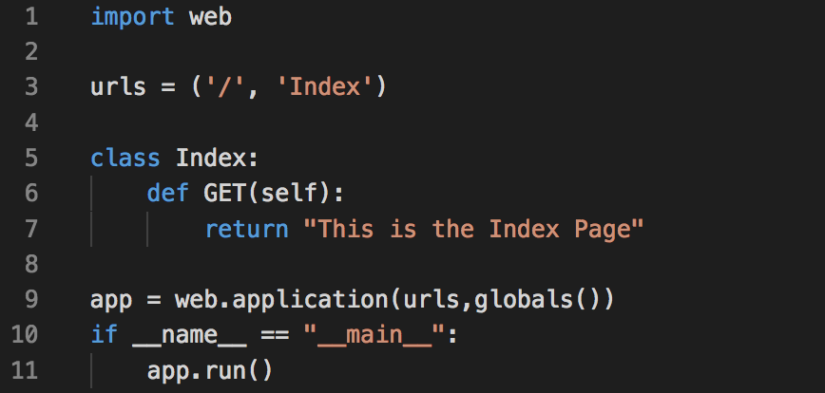
Building a web server

Slide 9
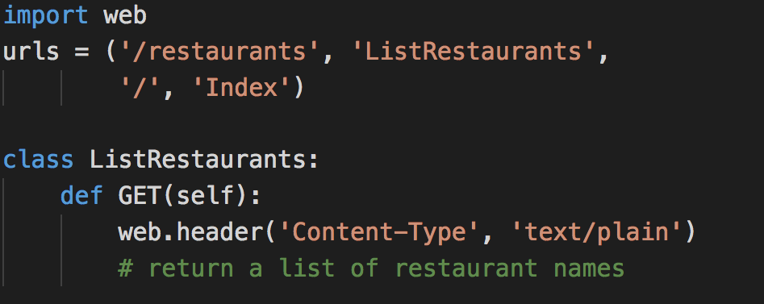
Passing Request data in
This is not a complete listing. You’ll need to modify your code from the previous slide.

Slide 10
Serving up data on the Interwebs
We want to be able to list the restaurants we have data about
Implement the ListRestaurants method from the previous slide.
You will need shared.py from a previous week’s exercises

